Slide 1
Milestone 2 : “Store data into hive data warehouse “
WQD7005 (Data Mining) Prof. Dr. Teh Ying Wah
Group members :
Sivanesan pillai (wqd 170074)
Mathavan Chandrasegaram (wqd 170075)

Slide 2
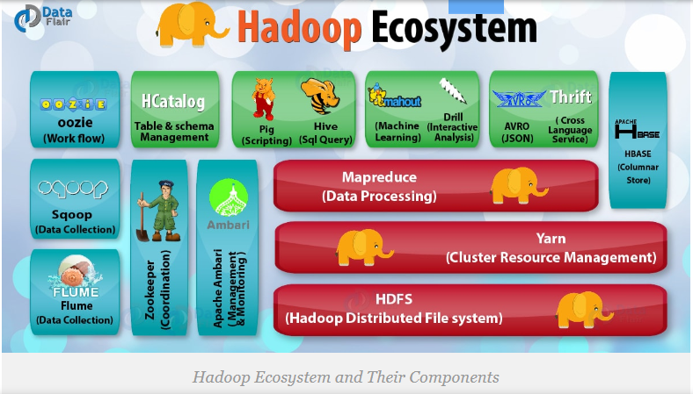
Hadoop Environment
Hadoop is an open-source software framework for storing data and running applications on clusters of commodity hardware. It provides massive storage for any kind of data, enormous processing power and the ability to handle virtually limitless concurrent tasks or jobs.

Slide 3
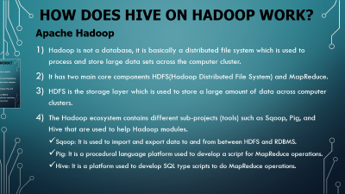
How does Hive on Hadoop work?
Apache Hadoop
Hadoop is not a database, it is basically a distributed file system which is used to process and store large data sets across the computer cluster.
It has two main core components HDFS(Hadoop Distributed File System) and MapReduce.
HDFS is the storage layer which is used to store a large amount of data across computer clusters.
The Hadoop ecosystem contains different sub-projects (tools) such as Sqoop, Pig, and Hive that are used to help Hadoop modules.
Sqoop: It is used to import and export data to and from between HDFS and RDBMS.
Pig: It is a procedural language platform used to develop a script for MapReduce operations.
Hive: It is a platform used to develop SQL type scripts to do MapReduce operations.

Slide 4

Apache HIVE
Hive is a data warehouse infrastructure tool to process structured data in Hadoop.
It is the excellent big data software that helps in writing, reading, and managing huge datasets present in the distributive storage.
It is an open source project built on top of Hadoop to summarize Big Data, and makes querying and analyzing easy.
There is a special language similar to SQL known as HiveQL that converts the queries into MapReduce programmes that can be executed on datasets in HDFS (Hadoop Distributed File System).
Hive is seen as a Data Warehouse Infrastructure and is used as an ETL (Extraction-Transformation-Loading) tool. It improves the flexibility in schema design with data serialization and deserialization. It is an excellent tool for querying historical data.

Slide 5
Step by step on how to store the data into hive
Created a directory into local system.
Save a data/file as in txt format into newly created directory.
Locate and view the data file.
Launch “HIVE” – data warehouse.
Check databases, create new database as petrol.
Use the newly created database (petrol), check for existing table, and create new table with defining all the required columns.
Load data from local file system into hive table.
Check and verified the data (petrolprice.txt) has successfully loaded into HIVE table (data warehouse)
Detail guide with commands : https://github.com/sivaliga/WQD7005-Milestone-2/blob/master/Milestone%202%20(Store%20data%20in%20HIVE%20data%20warehouse).pdf

Slide 6
Lets Move to LIVE Demo & THANK YOU Prof. Dr. Teh Ying Wah

